Slide 1

Group 48
Task Tracker
By:
Zachary Brienesse - 100921874
Param - 100978595
Humza - 100926654
Web & Script Programming - INFR-3120U

Slide 2
Group Task Distribution
Zachary Brienesse | Fix mongodb connection on render Make a functional navigation bar
Param | Making Showcase Video
Humza | Add login, register, and logout functionality Making sure register and login saves and remembers

Slide 3
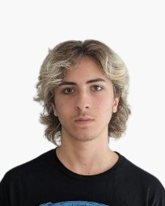
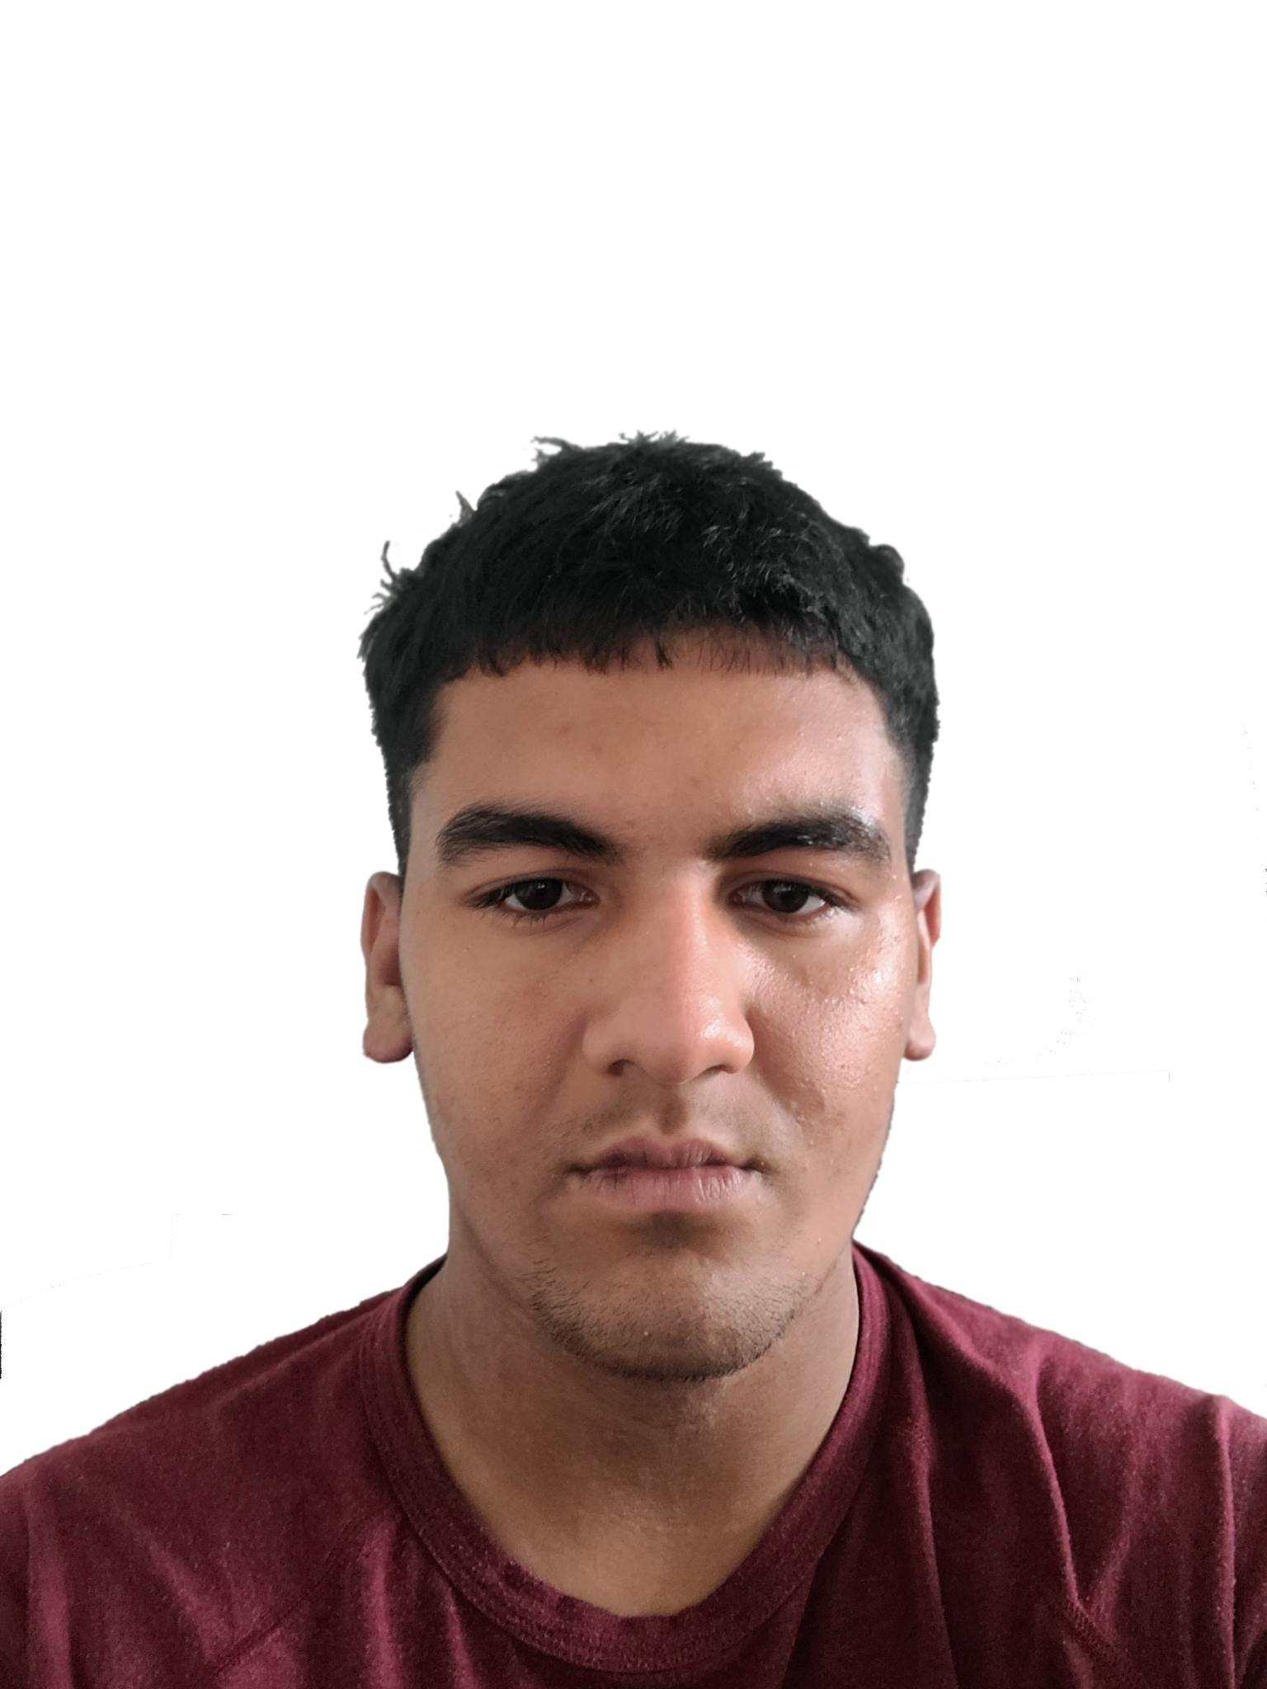
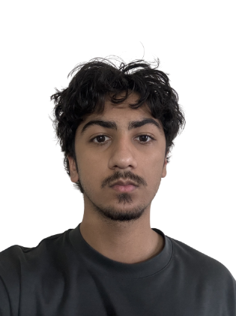
Meet us
Zachary Brienesse
Programmer
Param
Showcaser
Humza
Programmer

